Slide 1
Employee Data Analysis using Excel
STUDENT NAME:S.JENIFER
REGISTER NO:312216951
DEPARTMENT:B.COM(GENERAL)
COLLEGE:SHRI KRISHNASWAMY COLLEGE FOR WOMEN

Slide 2
PROJECT TITLE
Employee Performance Analysis using Excel

Slide 3


AGENDA
Problem Statement
Project Overview
End Users
Our Solution and Proposition
Dataset Description
Modelling Approach
Results and Discussion
Conclusion
3/21/2024 Annual Review

Slide 4

PROBLEM STATEMENT
Problem Statement:A company wants to analyze its salary and compensation data to identify trends, disparities, and areas for improvement. The data includes employee information, salary grades, job titles, departments, locations, and benefits. The company wants to create a dynamic and interactive model in Excel to:
1. Analyze salary distributions by department, location, and job title
2. Identify disparities in salary and benefits between different groups
3. Determine the impact of factors like experience, education, and performance on compensation
4. Develop a predictive model to estimate future salary and benefits costs
5. Create interactive dashboards to visualize and explore the data
Approach:
Data Preparation: Clean, transform, and structure the data in Excel tables.

Slide 5

PROJECT OVERVIEW
Objective:
Develop a comprehensive Excel data model to analyze salary and compensation data
Identify trends, disparities, and areas for improvement in compensation practices
Create interactive dashboards for data visualization and exploration
Provide insights and recommendations for optimizing salary and benefits structures
Scope:
Data collection and cleaning
Data modeling and relationship creation
Measure and calculation development
Data visualization and dashboard design
Analysis and insights generation
Deliverables:

Slide 6

WHO ARE THE END USERS?
1. HR Department: To inform compensation decisions, identify trends, and optimize salary structures.
2. Compensation and Benefits Team: To analyze and design competitive compensation packages, andensure compliance with regulations.
3. Finance Department: To budget and forecast salary and benefits expenses, and understand thefinancial impact of compensation decisions.
4. Management and Leadership: To make informed decisions about talent management, succession planning, and organizational development.
5. Line Managers: To understand salary ranges and make informed decisions about promotions, raises, and new hires.
6. Business Analysts: To analyze and interpret compensation data to inform business decisions.

Slide 7

OUR SOLUTION AND ITS VALUE PROPOSITION
Our solution, "Compensation Insights," is a comprehensive Excel-based data modeling tool that empowers organizations to analyze and optimize their salary and compensation structures. It includes:
1. Data Integration: A user-friendly data import process that consolidates data from various sources.
2. Data Modeling: A robust data model that creates relationships between employee data, salary grades, job titles, departments, and locations.
3. Analytical Dashboards: Interactive dash boards that provide insights into salary distributions, disparities, and trends.
4. Predictive Analytics: Forecasting tools that estimate future salary and benefits expenses.

Slide 8
Dataset Description
Data Sources:
1. Employee Data: Employee ID, Name, Job Title, Department, Location, Hire Date, Termination Date (if applicable)
2. Salary Data: Employee ID, Salary Grade, Base Salary, Bonus, Benefits, Total Compensation
3. Job Title Data: Job Title, Job Description, Job Family, Job Level
Data Fields:
1. Employee ID (unique identifier)
2. Job Title
3. Department
4. Location
Data Types:
1. Numeric: Salary, Bonus, Benefits, Total Compensation

Slide 9

THE "WOW" IN OUR SOLUTION
Automated Data Visualization: With Excel's powerful data visualization tools, you can create interactive and dynamic dash boards that provide real-time insights into compensation trends and patterns.
Predictive Analytics: Using Excel's advanced formulas and functions, you can build predictive models that forecast future compensation needs and identify potential talent acquisition and retention challenges.
Data-Driven Storytelling: Your solutionpresents complex compensation data in a clear and compelling narrative, enabling stakeholders to make informed decisions and drive business outcomes.
Actionable Insights: Your solution provides concrete recommendations and actionable steps for optimizing compensation packages, improving employee satisfaction, and driving business growth.
3/21/2024 Annual Review
9

Slide 10
MODELLING
Step 1: Data Collection
Gather data on salaries, compensation, and relevant factors (e.g., job title, department, location, experience, performance ratings)Import data into Excel from various sources (e.g., HR systems, surveys, market research)
Step 2: Data Cleaning
Ensure data accuracy and handle missing valuesPerform data transformation as needed (e.g., converting text to numbers)
Step 3: Data Modeling
Create an Excel data model to organize and structure the dataEstablish relationships between tables (e.g., employee-job-department)
Step 4: Data Analysis
Use Excel formulas, functions, and data visualization techniques to analyze and gain insights from the data
Step 5: Reporting
Present findings and insights through clear and effective reports, dash boards, or presentationsUse Excel charts, tables, and visualization tools to communicate results
10

Slide 11
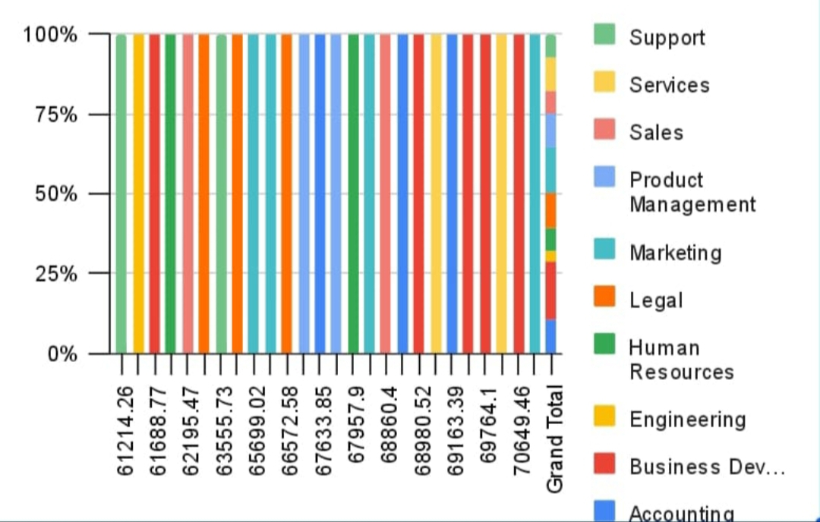
RESULTS
11

Slide 12
conclusion
In conclusion, the Salary and Compensation Analysis through Excel data modeling presents a powerful and comprehensive solution for optimizing compensation packages and driving business success. By leveraging Excel's data modeling capabilities, organizations can gain a deeper understanding of their compensation structure, identify trends and patterns, and make data-driven decisions. The solution offers automated data visualization, predictive analytics, and data-driven storytelling, providing actionable insights and recommendations for improvement. Its scalability, flexibility, and integration with other HR systems make it a robust tool for compensation analysis. With this solution, organizations can ensure fair and competitive compensation packages, improve employee satisfaction, and drive business growth. By harnessing the power of Excel data modeling, organizations can unlock the full potential of their compensation data and achieve a sustainable competitive advantage in the market.

